Slide 1
ISLR Chapter 4.4 Linear Discriminant Analysis (LDA)
Reviewed by: Kezhen Fei
11/21/2014

Slide 2
Logistic regression is available why LDA?
When the classes are well-separated, the parameter estimates for the logistic regression model are surprisingly unstable.
If n is small and the distribution of the predictors X is approximately normal in each of the classes, LDA model is more stable.
LDA is popular when response classes > 2

Slide 3

How is LDA carried out?
Logistic regression: Maximum likelihood method:
In LDA:
Model the distribution of the predictors X in each of the response classes separately:
Use Bayes Theorem to flip it around to get:

Slide 4
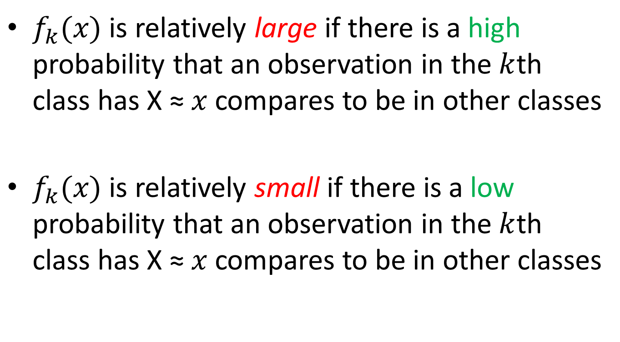
Reasoning for using Bayes’ Theorem
$f_{k}(x)$ is relatively large if there is a high probability that an observation in the $k$th class has X ≈ $x$ compares to be in other classes
$f_{k}(x)$ is relatively small if there is a low probability that an observation in the $k$th class has X ≈ $x$ compares to be in other classes

Slide 5

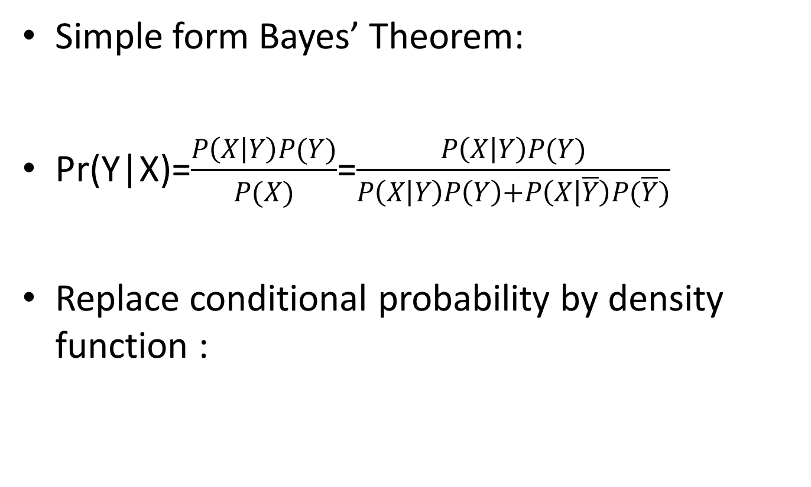
Bayes’ Theorem
Simple form Bayes’ Theorem:
Pr(Y|X)=$\frac{P\left(X | Y\right)P(Y)}{P(X)}$=$\frac{P\left(X | Y\right)P(Y)}{P\left(X | Y\right)P\left(Y\right)+P\left(X | \overline{Y}\right)P(\overline{Y})}$
Replace conditional probability by density function :

Slide 6
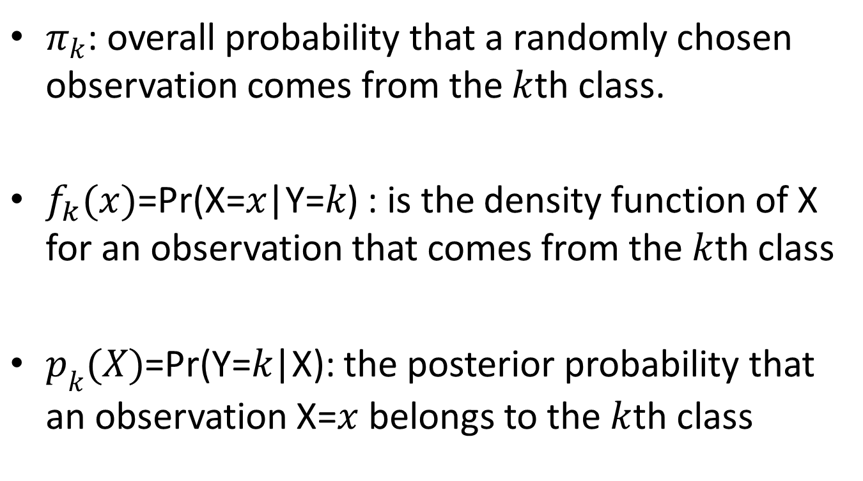
Review of the notations:
$π_{k}$: overall probability that a randomly chosen observation comes from the $k$th class.
$f_{k}(x)\text{=}\text{Pr}\text{(}\text{X}\text{=}x\text{|}\text{Y}\text{=}k\text{) }$: is the density function of X for an observation that comes from the $k$th class
$p_{k}(X)$=Pr(Y=$k$|X): the posterior probability that an observation $\text{X}\text{=}x$ belongs to the $k$th class

Slide 7
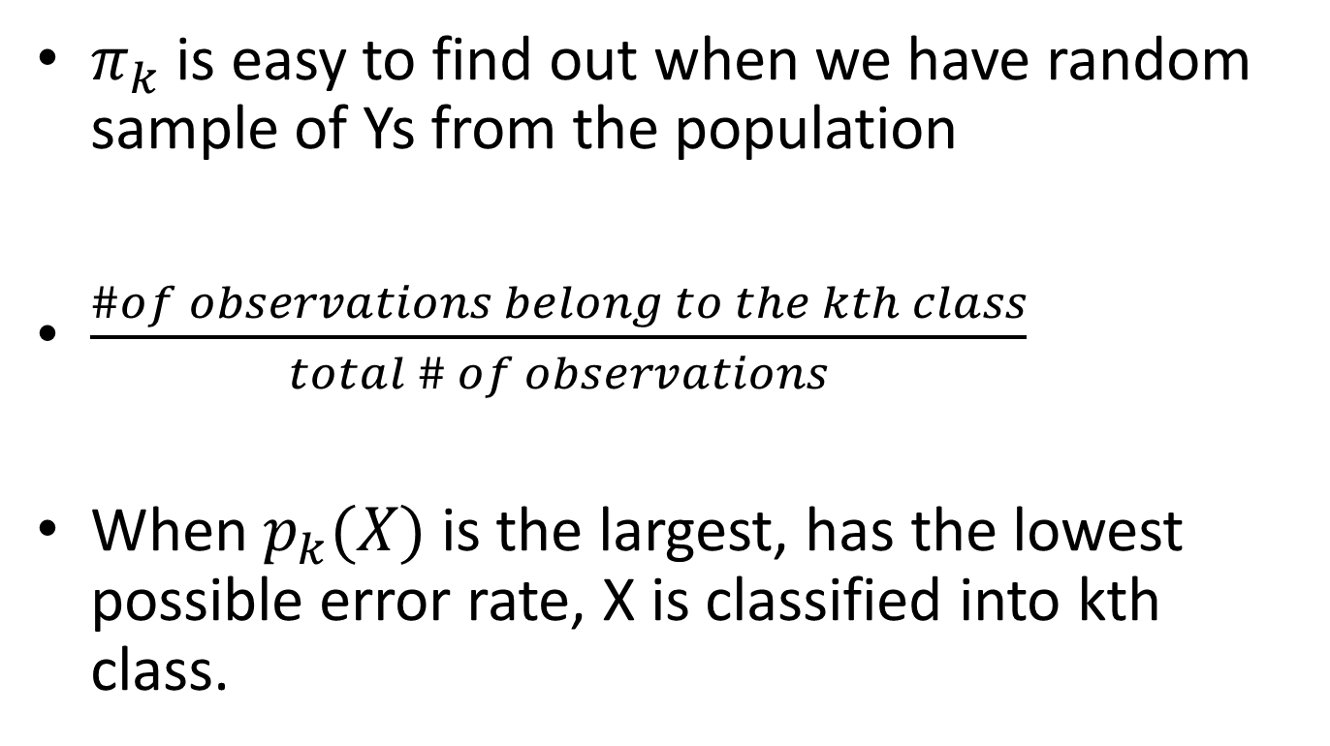
How to estimate?
$π_{k}$ is easy to find out when we have random sample of Ys from the population
$\frac{\#of observations belong to the kth class}{total \# of observations}$
When $p_{k}(X)$ is the largest, has the lowest possible error rate, X is classified into kth class.

Slide 8

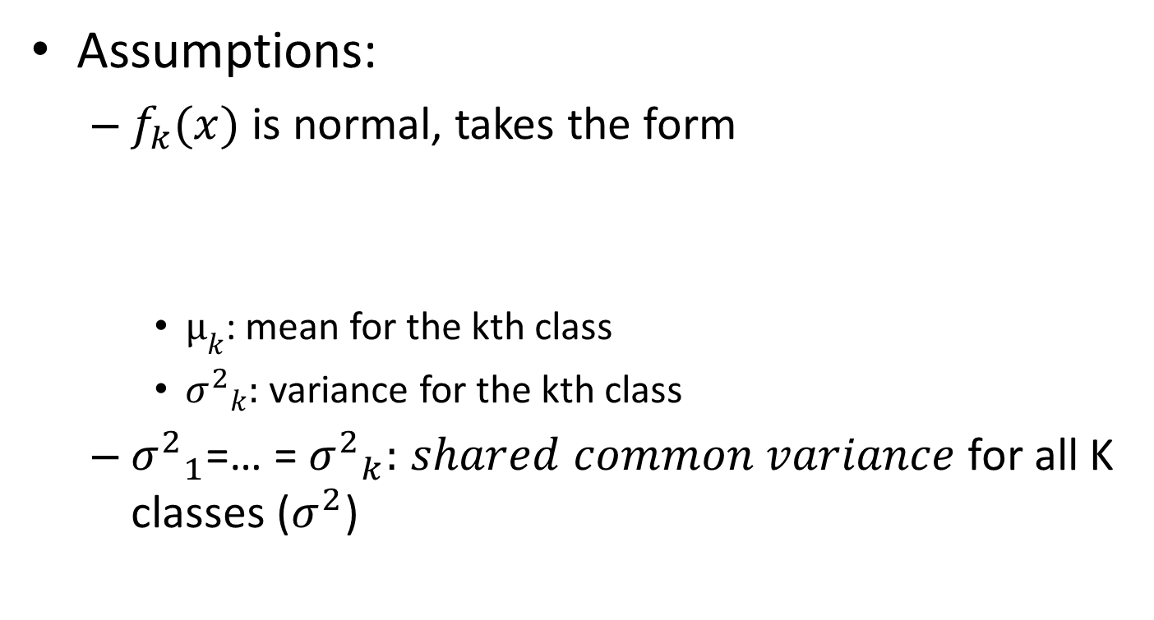
LDA for p=1
Assumptions:
$f_{k}(x)$ is normal, takes the form
$µ_{k}$: mean for the kth class
${σ^{2}}_{k}:$ variance for the kth class
${σ^{2}}_{1}$=… = ${σ^{2}}_{k}:$ $shared common variance$ for all K classes ($σ^{2}$)

Slide 9


LDA for p=1 (Cont’d)
After we plugging the normal density function 4.11 into the posterior probability function 4.10, we get:
Take a log:

Slide 10
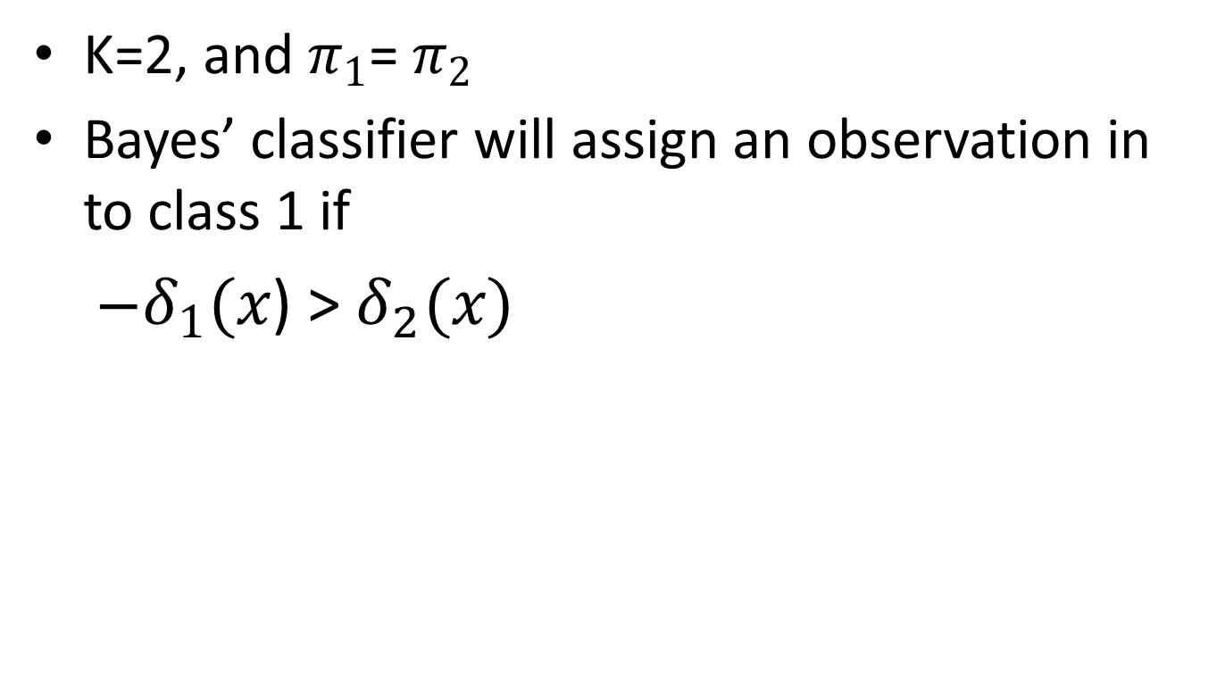
LDA for p=1 (example)
K=2, and $π_{1}$= $π_{2}$
Bayes’ classifier will assign an observation in to class 1 if
$δ_{1}(x$) > $δ_{2}(x)$

Slide 11
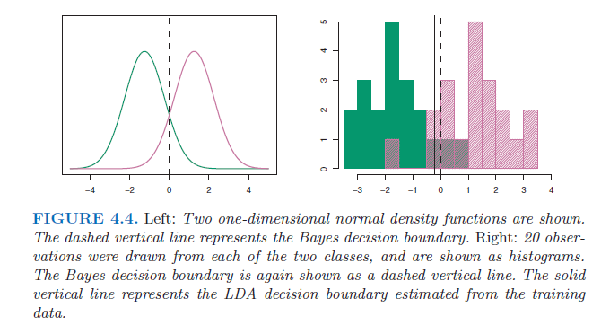

LDA for p=1 (example cont’d)
Bayes decision boundary: $\frac{µ_{1}+µ_{2}}{2}$
LDA Decision Boundary

Slide 12
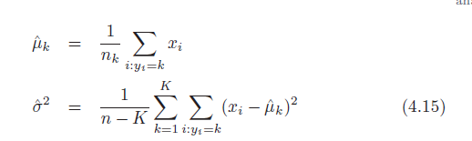

In reality
We need to estimate all the parameters:
Linear Discriminant function:

Slide 13
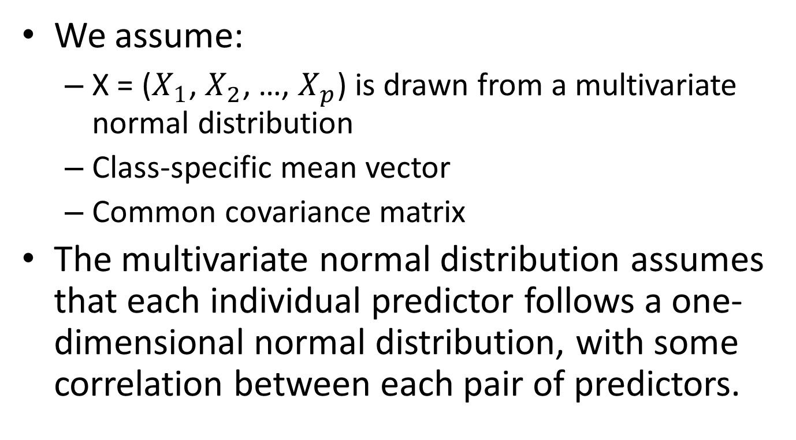
LDA for p > 1
We assume:
X = ($X_{1}$, $X_{2}$, …, $X_{p}$) is drawn from a multivariate normal distribution
Class-specific mean vector
Common covariance matrix
The multivariate normal distribution assumes that each individual predictor follows a one-dimensional normal distribution, with some correlation between each pair of predictors.

Slide 14
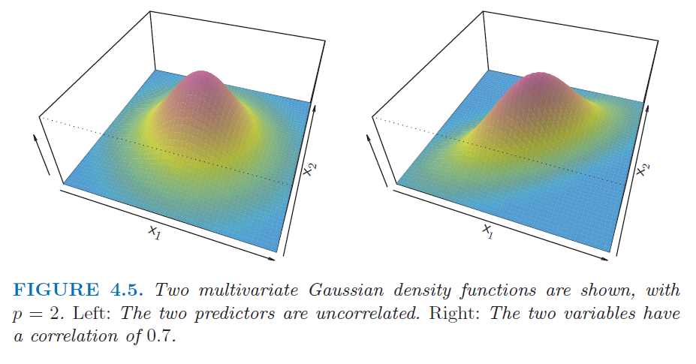
Example. Multivariate Normal Distribution

Slide 15


LDA with p-dimensional normal predictors
X ~ N(μ, Σ)
E(X) = μ (a vector with p components)
Cov(X) = Σ (p*p covariance matrix of X)
Multivariate density function
Bayes’ classification funcion

Slide 16
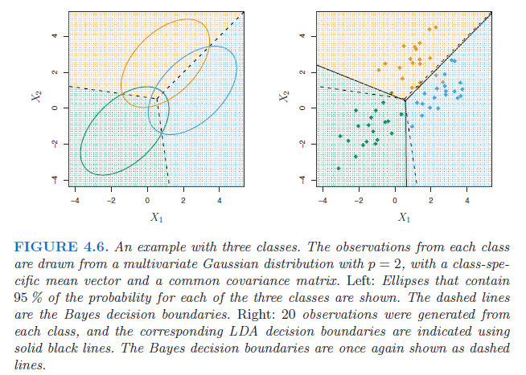
Example. Classification for Three Response Classes from Two Predictors with Multivariate Normal Distribution

Slide 17
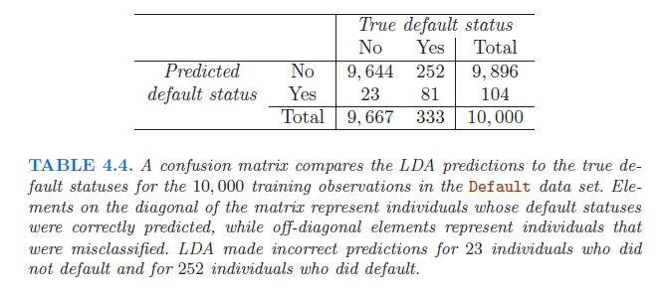
LDA on the Default data
Predictors:
credit card balance
student status

Slide 18
Error Rate
Training error rate at 2.75%
But the error rate among people defaulted is 252/333= 75.7%
If we think LDA as a test, then sensitivity of the test to correctly identify true defaulters is very low at 24.3%
Although the specificity is high at 99.8%

Slide 19
Reason for the high error rate
LDA is trying to approximate Bayes’ classifier, which has the lowest TOTAL error rate out of all classifier, by classifying observations into the class with the largest posterior probability with threshold of 50%
But credit card companies want to identify defaulters with a lower threshold

Slide 20
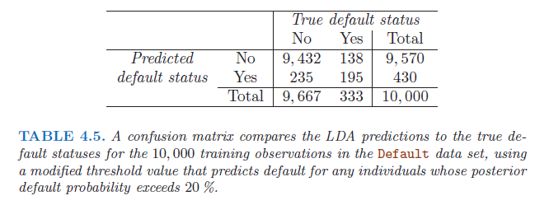
Confusion table with lower threshold
Now more defaulters are correctly identified as the credit card company like, but with a cost that 235 non-defaulters are incorrectly classified.

Slide 21
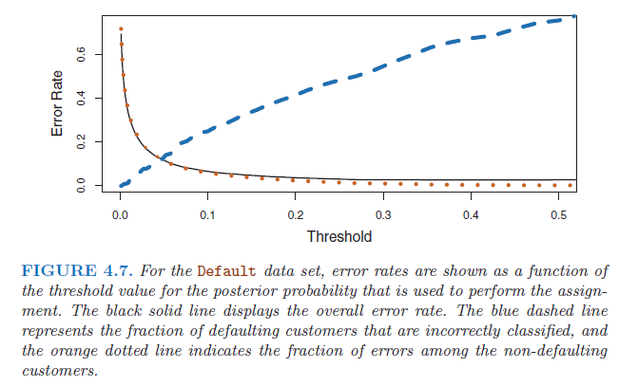
Threshold and Error Rate

Slide 22
Quadratic Discriminant Analysis (QDA)
LDA assumes the observations within each class drawn from a multivariate normal distribution with a class mean vector and a covariance matrix that is common
The only difference is that QDA assumes that each class has its own covariance matrix.

Slide 23
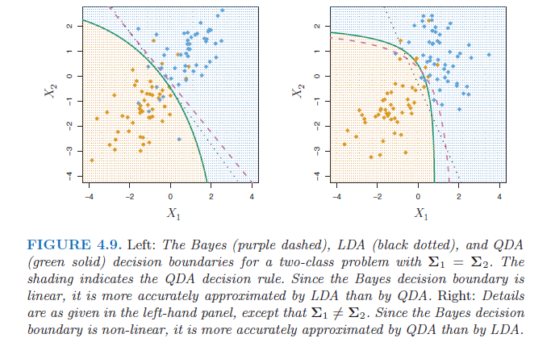
LDA & QDA
When covariance matrixes are not equal between classes, QDA is a better approximation to Bayes than LDA.

Slide 24
Comparison of Classification Methods (LR & LDA)
Logistic regression (LR) and LDA methods are closely connected, both produce linear decision boundaries.
Only difference between LR and LDA is that, the parameters are estimated using maximum likelihood for LR and using estimated mean and variance from a normal distribution.
They often give similar results, but not always.
LDA outperforms LR when normal distribution and common variance assumptions approximately hold; and LR outperforms LDA when normal assumptions are not met.

Slide 25
Comparison of Classification Methods (KNN)
KNN takes a complete non-parametric approach, no assumptions are made about the shape of the decision boundary
KNN dominates LR and LDA when the decision boundary is highly non-linear
KNN doesn’t tell which predictors are important, no coefficients are estimated

Slide 26
Comparison of Classification Methods (QDA)
QDA is a compromise between KNN (non-parametric and LDA (linear) and LR
QDA assumes a quadratic boundary, it can accurately model a wider range of problem than linear models
QDA not as flexible as KNN, but can outperform KNN with limited # of training observations.

Slide 27
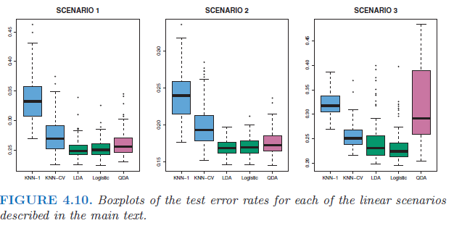
Comparisons of linear scenarios
Uncorrelated Normal Predictors
correlated Normal Predictors
t-distribution Predictors

Slide 28
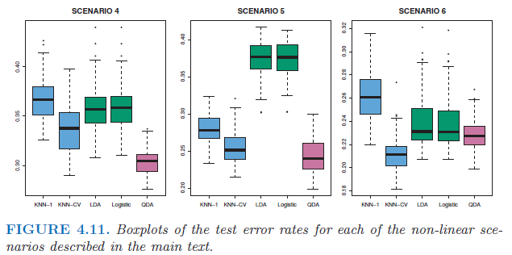
Comparisons of non-linear scenarios
Correlated Normal Predictors without common covariance matrix between classes
Uncorrelated Normal Predictors within class; Responses from logistic functions of quadratic predictors
Uncorrelated Normal Predictors within class; Responses from complex non-parametric functions

Slide 29
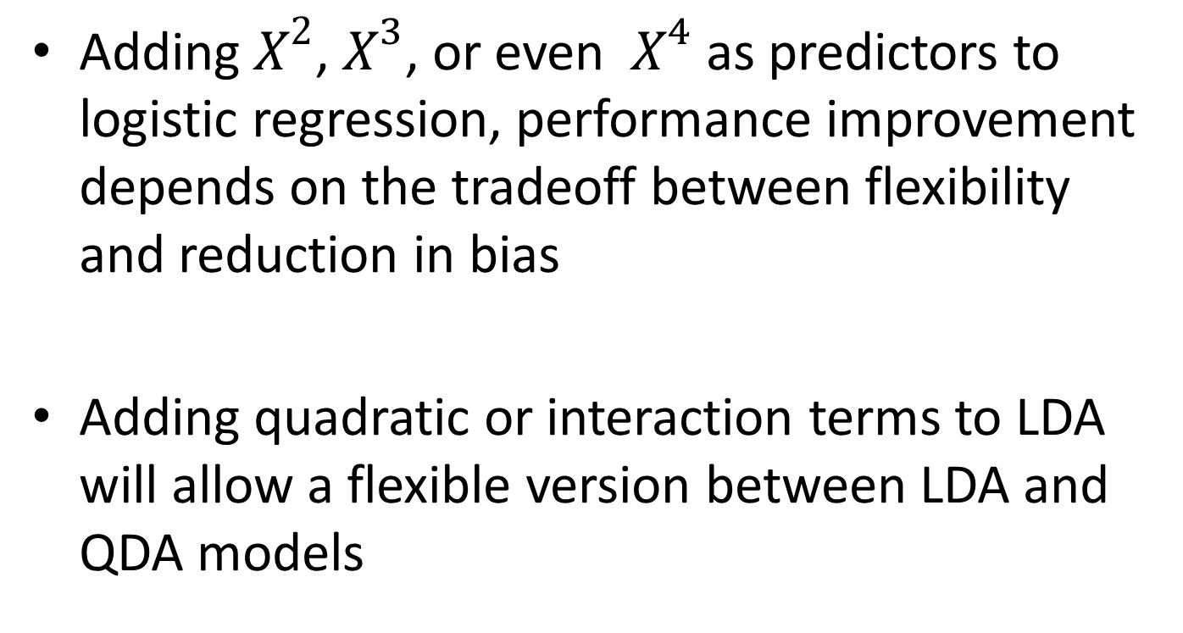
Accommodating non-linear relationships
Adding $X^{2}$, $X^{3}$, or even $X^{4}$ as predictors to logistic regression, performance improvement depends on the tradeoff between flexibility and reduction in bias
Adding quadratic or interaction terms to LDA will allow a flexible version between LDA and QDA models

